Slide 1

Exploiting Geographic Dependencies for Real Estate Appraisal
Yanjie Fu
Joint work with Hui Xiong, Yu Zheng, Yong Ge, Zhihua Zhou, Zijun Yao Rutgers, the State University of New Jersey
Microsoft Research, UNC Charlotte, Nanjing University
KDD2014@New York City, NY
Notes:
Hello, everyone. Thank you for attending my talk. My name is Yanjie Fu, from Rutgers University. I am now working with Prof. Hui Xiong. And this work is about exploiting geographic dependencies for real estate appraisal.

Slide 2
Agenda
Background and Motivation
Problem Statement
Methodology
Evaluation
Conclusions
Notes:
Here is the agenda of my talk today. I am going to start with background and motivation.

Slide 3



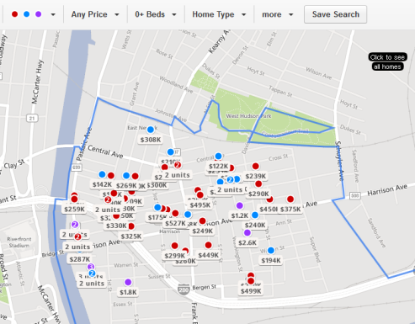
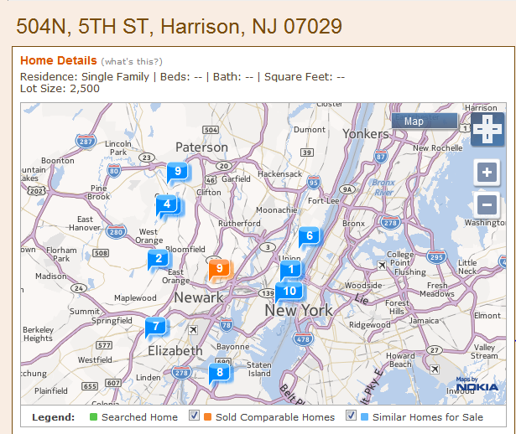
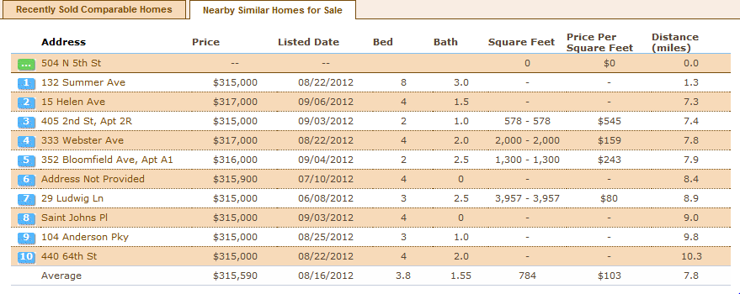
Housing Matters
Settle down your family
Make extra money as investment
Win your lover
Zillow
Realtors
Yahoo Homes
housing consultant services
Call for an intelligent system to rank estates based on estate investment value
Notes:
Buying a house
Win your lover
Settle down your family
Make more money
Estate information systems are too simple and sometimes native
Zillow, Yahoo! Homes, Realtors, etc
Spatial nearby search + facet ranking (distance , price , square, etc)

Slide 4
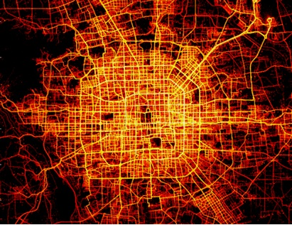
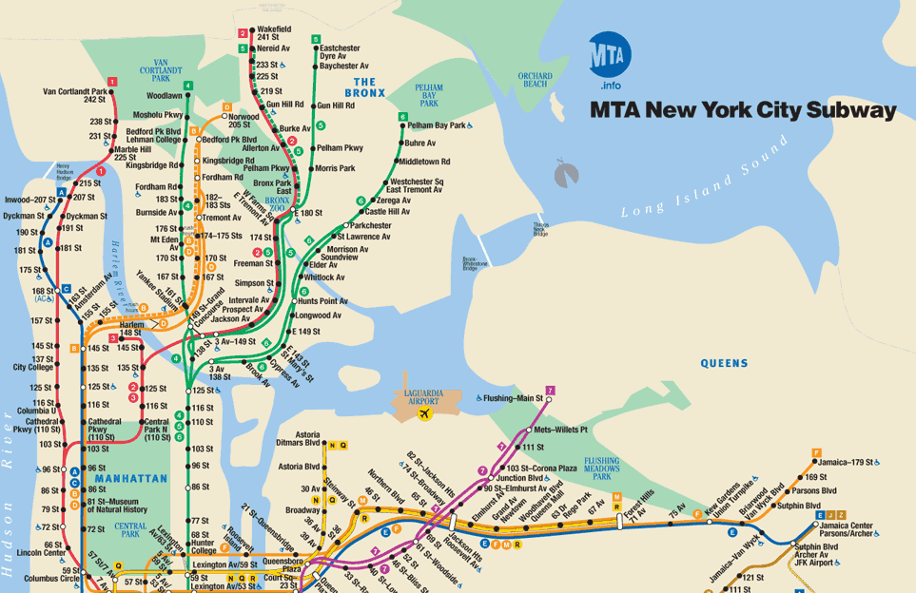
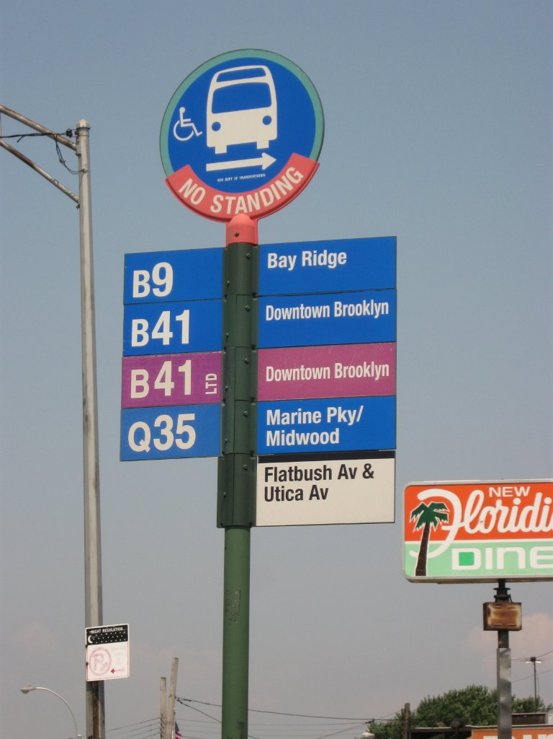
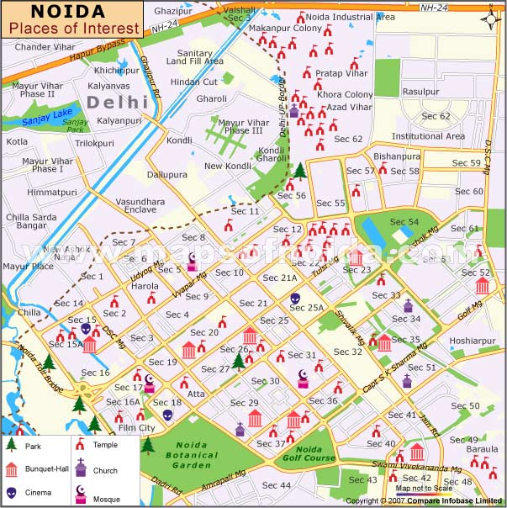
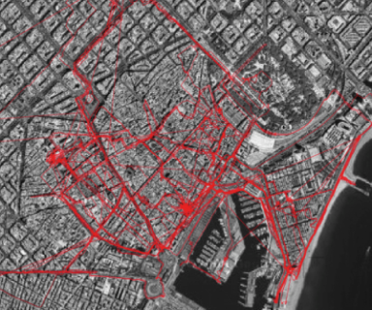
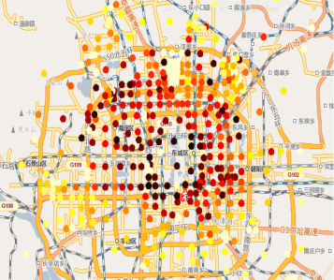
What Special in Estate Investment Value
Location! Location! Location!
Urban Geography features the geographical utility of houses
Human Mobility reflects neighborhood popularity of houses
Prosperity of Business Area shows influence on houses
Road Networks
Subway Stations
Bus Stops
Places of interests
Taxi GPS traces
Businesses area

Slide 5
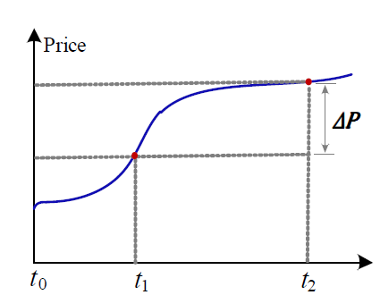
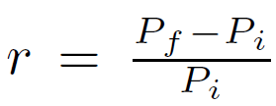
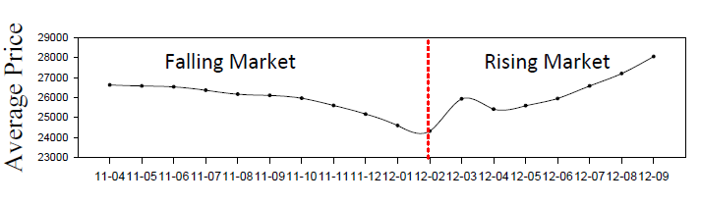
Quantifying Estate Investment Value
We don’t predict future price
We predict growth potential of resale value (long term thing)
Estate investment return rate of a given market period
Prepare the benchmark investment values of estates for training data
Identify rising market period and falling market period of Beijing
Calculate the investment returns of each real estate during rising market period and falling market period
Value-adding capability
investment returns of rising market period
Value-protecting capability
investment returns of falling market period represent
Investment return

Slide 6
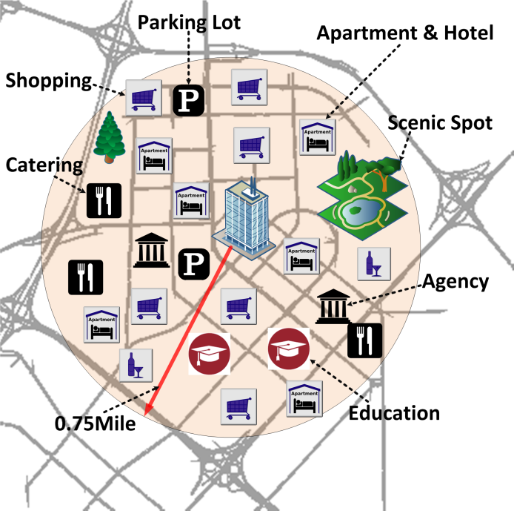
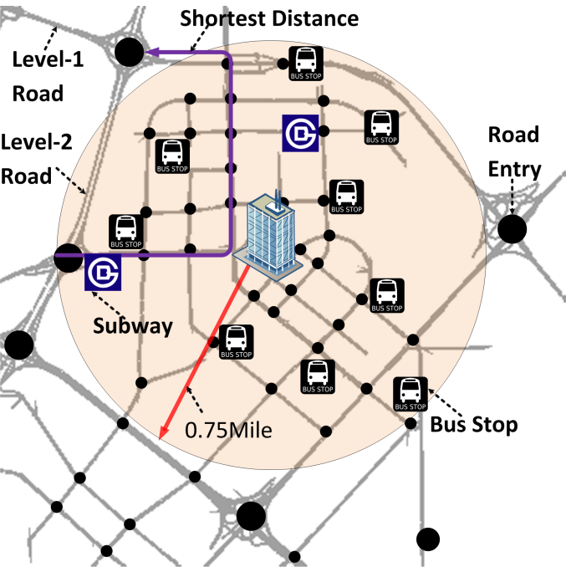
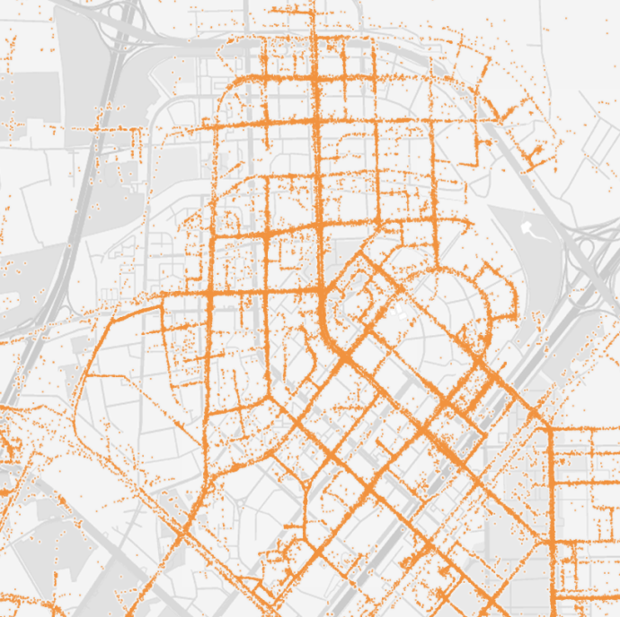

Geographic Dependencies (1)
Your personal profiles tell your research interests
Point of Interest
Transportation Accessibility
Taxi Mobility
Individual dependency
the investment value of an estate is determined by the geographic characteristics of its own neighborhood
Notes:
Now I am going to introduce three geographic dependencies of real estate investment value: individual, peer, and zone dependencies . Imagine that now I want to recruit a phd student as my research assistant. I want to observe your research potentials. Firstly, I will observe your GPA, projects, intern experiences and publications, because these tells your hard and soft capability in your research. Similarly, the investment value of an estate is determined by geographic features, good geographical featurs means a high investment value.

Slide 7
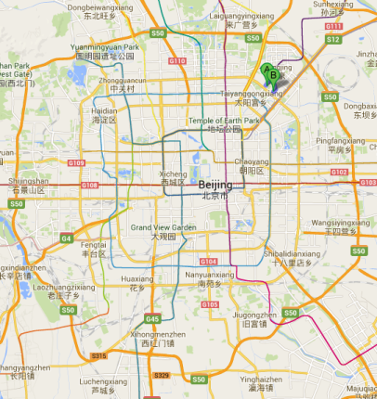
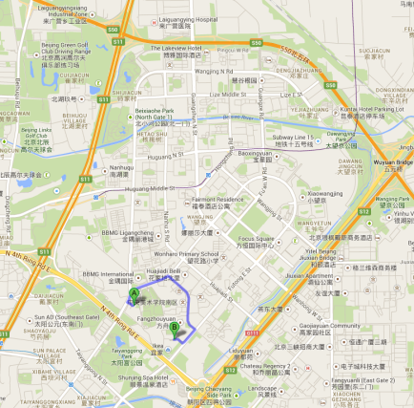
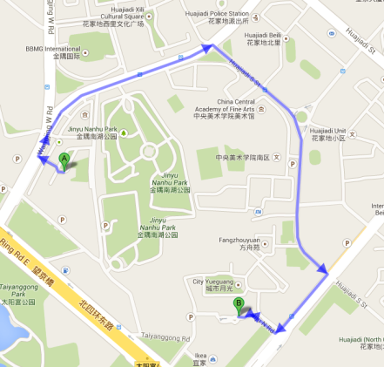
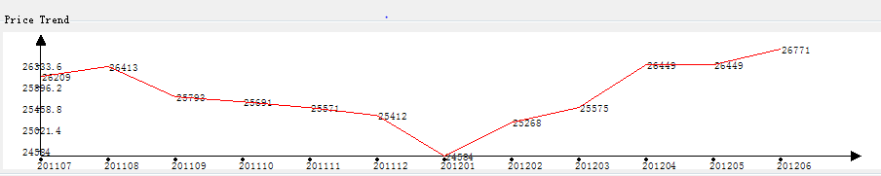
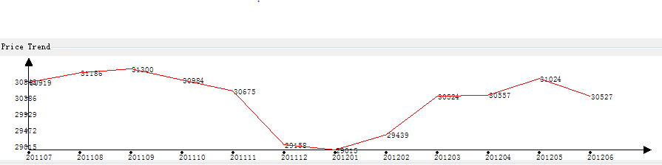
Geographic Dependencies (2)
Your friends tell your research interests
A
B
A
B
Attribute | A | B
Distance to Level2 road network | 156 meters | 143 meters
Distance to subway station | 1385 meters | 1585 meters
#Restaurants | 3 | 4
#Transportation facilities | 8 | 8
Peer dependency
Inside a business area, the estate investment value can be reflected by its nearby estates.
Notes:
Second, I will observe your friends, because the research performance of your friends tell your research potentials. We call that peer dependency. Similarly, if your two houses are very close to each other, the investment potentials should be very close. Here, I select two very close houses in Beijing. We find that in the rising market and falling market period, their base prices, trend and fluctuation are mostly the same. Their geographic attributes are also similar.

Slide 8
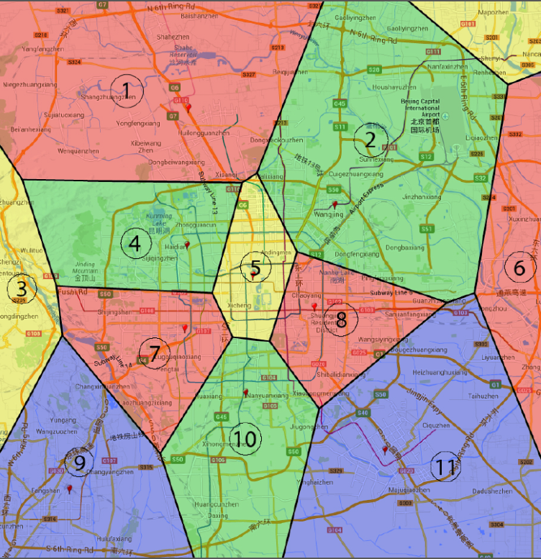

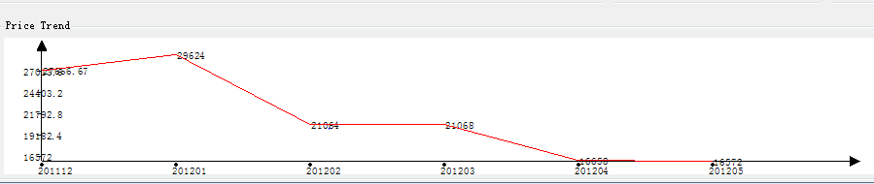
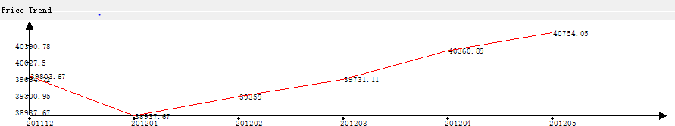
Geographic Dependencies (3)
Your associated research groups tell your research interests
Depressed business area
Rising Market Period (02/2012-05/2012)
Prosperous business area
Depressed business area
Average regional prices
Prosperous business area
Average regional prices
Zone dependency
The estate value can also be influenced by the values of its associated latent business area.
Notes:
Third, I will observe your previous affiliated research groups. If you used to work in top research groups, I assume you have good academic training. Similarly, if a house is located in a prosperous business area, this house is quite likely to have high value-adding capability and value-protecting capability.

Slide 9
Problem Definition
Given
Estates with locations and historical prices
Urban geography (poi, road networks)
Human mobility (taxi GPS traces)
Objective
Rank estates based on their investment values
Core tasks
Predict estate investment value using urban geography and human mobility
Jointly model three geographic dependencies as objective function to learn estate ranking predictor
Notes:
So, here we come to the problem statement:
Given estates with locations and historical prices

Slide 10
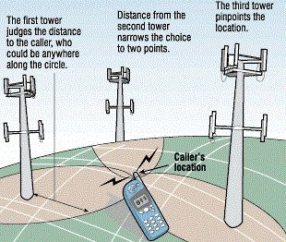
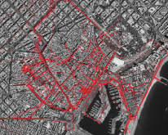
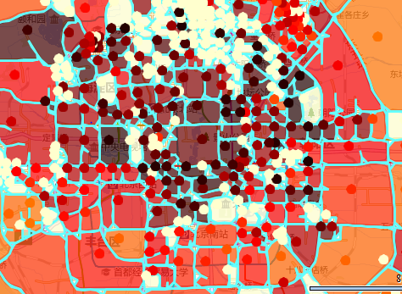
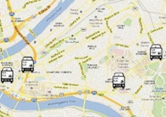
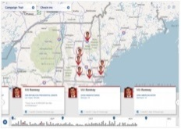
Methodology Overview
Estate Investment Value
Location
Geographic Utility
Neighborhood Popularity
Influence of Business Area’s Prosperity
Urban Geography
Human Mobility
Business Area
Prediction
Model
Road Networks
Subway Stations
Cell -Tower Traces
Taxicab GPS Traces
Bus Stops
Places of interests
Bus Traces
Check-ins
Individual Dependency
Peer Dependency
Zone Dependency
Objective
Function

Slide 11
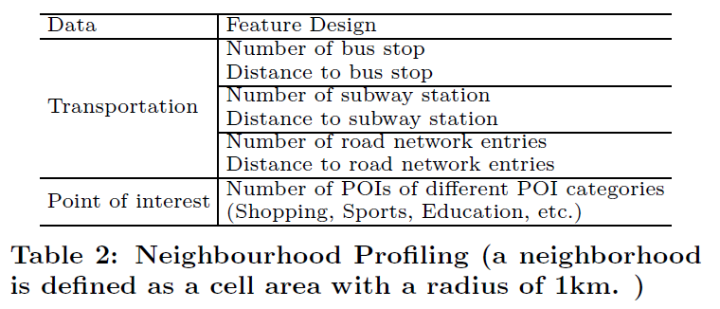
Modeling Estate Investment Value (1)
Geographic Utility
Feature extraction by spatial indexing
linearly regress geographic utility from geographic features of the neighborhood of each estate

Slide 12
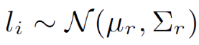
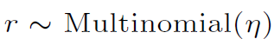
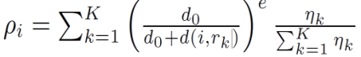
Modeling Estate Investment Value (2)
Influence of business area (A generative view)
There are K business areas in a city
Each business area is a cluster of estates; estates tend to co-locate along multiple business areas
The more prosperous, the more easier we identify an estate from business area
The prosperities of K business areas (K spatial hidden states ) show influence on estates
The inverse influence of geo-distance between estate and business area center
Gaussian Mixture Model + Learning To Rank
Prosperities of K business areas

Slide 13


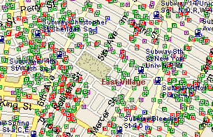



Modeling Estate Investment Value (3)
Neighborhood Popularity (A propagation view)
Propagate visit probability to POIs per drop-off point
Aggregate visit probability per POI
Aggregate visit probability per POI category
Compute popularity score
Spatial propagation and aggregation from taxi to house
Taxi
Point of Interests
Categories of POI
House
Passenger
(drop-off point)

Slide 14
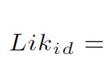
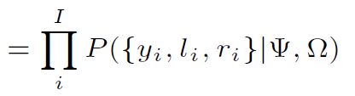
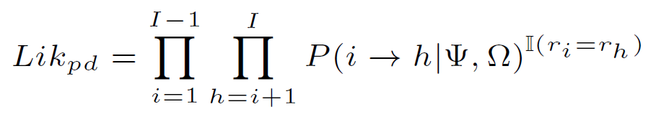
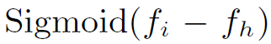
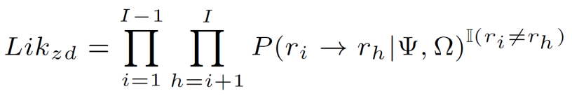
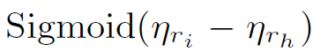
Modeling Three Dependencies
Individual Dependency
Capture prediction accuracy of investment values , locations and business area assignment
The more accurate, the higher likelihood
Peer Dependency (pairwise analysis on estate level)
Capture ranking consistency of predicted investment value of each estate pair
Zone Dependency (pairwise analysis on business area level)
Capture ranking consistency of learned prosperities of the corresponding business area pair of each estate pair
Overall likelihood

Slide 15
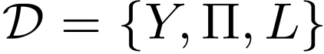

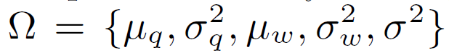
Parameter Estimation
Given where Y , and L are the investment value, ranks and locations of I estates respectively
To maximize the posterior
Parameters Priors
Expectation Maximization (EM) to learn the parameters by treating latent business area of each estate as a latent variable
Geo-clustering updates the latent business area by maximizing the posterior of latent business area
After business area assignments are updated, maximizing the posterior of model parameters

Slide 16
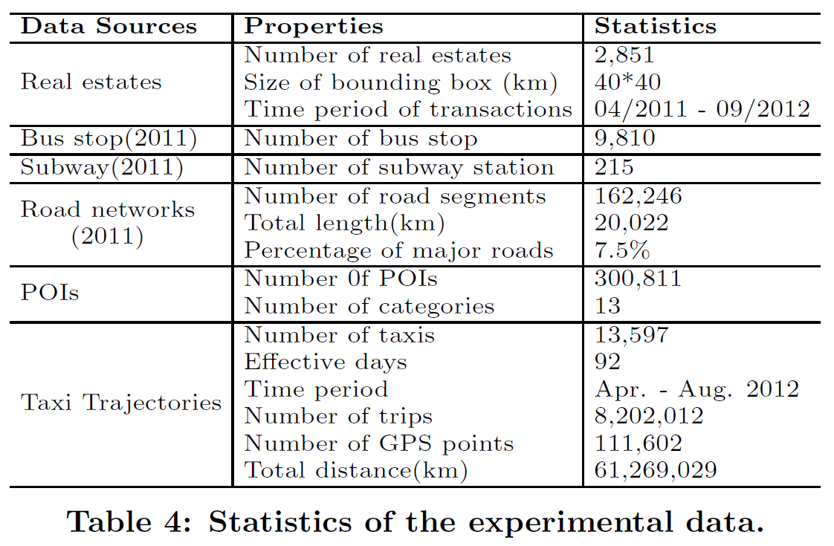
Experimental Data
Beijing real-world Data
Beijing estate data
2851 estates with transaction records from 04/2011 to 09/2012
Falling market(04/2011 to 02/2012) and Rising market (02/2012 to 09/2012)
Beijing transportation facility data including bus stop, subway, road networks
Beijing POI data
Beijing taxi GPS traces

Slide 17
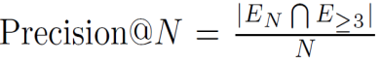
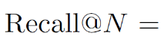
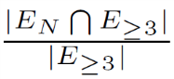
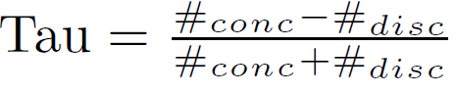
Evaluation Methods and Metrics
Baseline algorithms
MART: it is a boosted tree model, specifically, a linear combination of the out puts of a set of regression trees
RankBoost: it is a boosted pairwise ranking method, which trains multiple weak rankers and combines their outputs as final ranking
Coordinate Ascent: it uses domination loss and applies coordinate descent for optimization
ListNet: it is a listwise ranking model with permutation top-k ranking likelihood as the objective function
Evaluation metrics
Normalized Discounted Cumulative Gain (NDCG)
Precision
Recall
Kendall’s Tau Coefficient

Slide 18
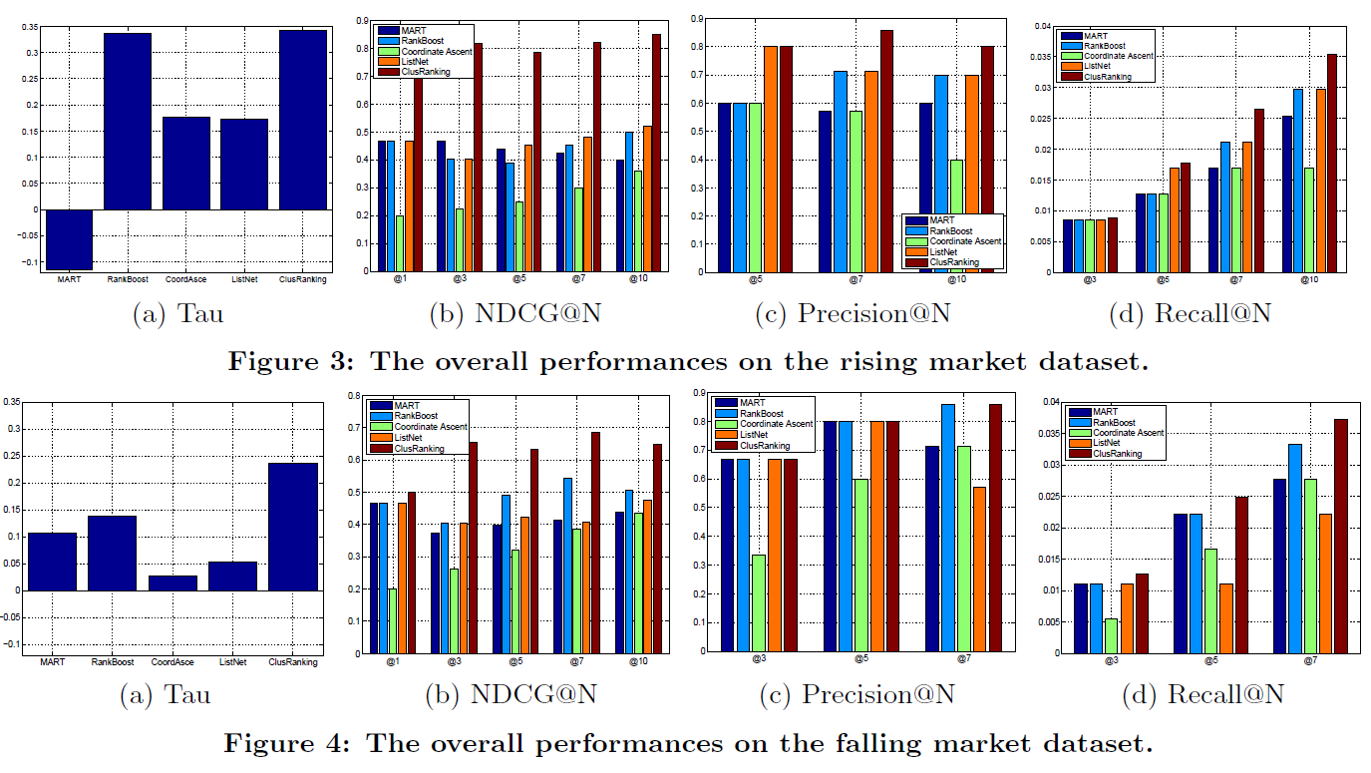
Overall Performances
We investigate the ranking performances by comparing to baseline algorithms in terms of Tau, NDCG, Pecision and Recall
Our method mines urban geography and human mobility to predict estate investment value and exploit three dependencies, and thus outperform traditional LTR methods

Slide 19
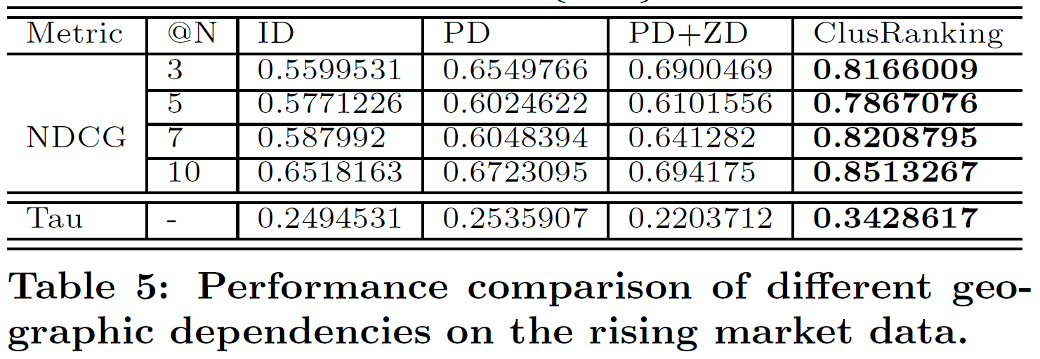
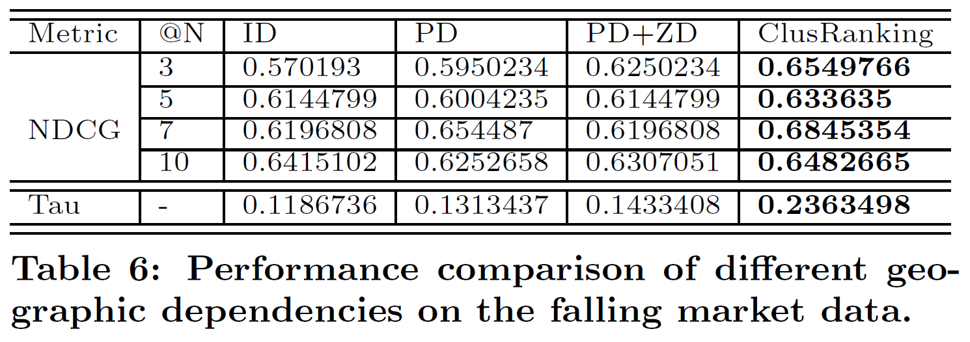
Study on Geographic Dependencies
We study the impact of three geographic dependencies by designing different variants of objective function (posterior likelihoods)
Individual dependency can achieve good overall ranking performance;
Peer and zone dependency can achieve good top-k ranking performance;
We recommend combination usage of three dependencies

Slide 20
Hierarchy of Needs for Human Life (1)
Triangle Need Structure of Human Being
We hope we go shopping, work, eat, access transportation quickly and easily, children go to schools near our home
We DONOT need hotels/hospitals/sports/spots located near our home
The POI density spectral of estates over multiple poi categories
Good house is always balance people’s need

Slide 21
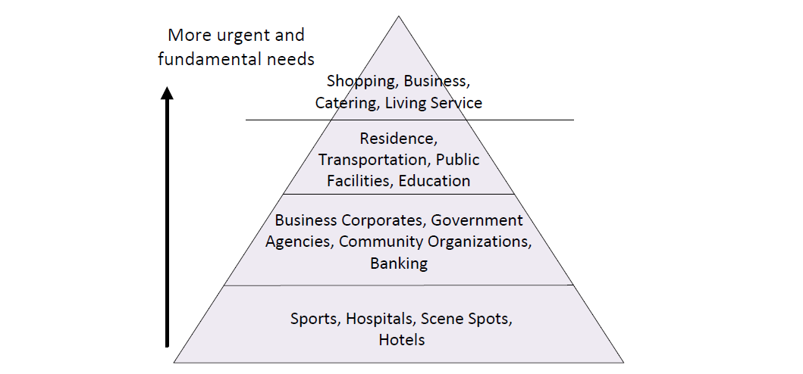
Hierarchy of Needs for Human Life (2)
The triangle need structure of human life in Beijing

Slide 22
Conclusions
Housing analysis is funny
Use urban geography and human mobility to model estate investment value
Capture geographic individual, peer, and zone dependencies to better learn estate ranking predictor
Business applications
Decision making support for homebuyers
Improve price structure for housing agent/broker/consultant
Optimize site selection for housing developer

Slide 23

Thank You !
Email: yanjie.fu@rutgers.edu
Homepage: http://pegasus.rutgers.edu/~yf99/
Notes:
23

